Slide 1
ADVANCED DEPOSITION PRACTICE
500 N. Broadway, Suite 1350
St. Louis, MO 63102
314-542-2222
BurgerLaw.Com

Slide 2
Witness Preparation
Deposition preparation videos
Three basic rules:
  Understand the question being asked
  Listen to and answer only that question
  “I don’t know” is a good answer
Role-play with witnesses to work on the rules
  Act like the other lawyer
  Fix problems before going on the record

Slide 3
Witness Preparation
Review docs
  Interrogatories, petition, medical records
Work chronologically with client
  Timelines, dates of events, when things were said
Better preparation = better performance
“Everything is possible” - not in a deposition

Slide 4
Video tape your own depositions of parties and key witnesses
  No certification needed – Rule 57.03
  Sync video with transcript later
  Play video at trial
Who can be there? Anyone.

Slide 5
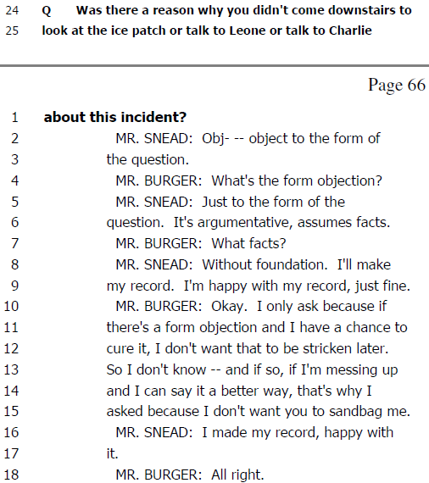
Form objections – call them out

Slide 6
Overly instructing/answering attorney – call them out
  Too burdensome? Stop the deposition, go to court
  OR: take out a second camera and point it at the offending attorney

Slide 7
TAKE BREAKS if client is not listening to advice
  Continue teaching witness throughout
  Start out nice, but get more aggressive and woodshed the witness if they refuse to listen
WHO TO DEPOSE don’t forget the little people
  Physical therapists
  Police officers

Slide 8
BIG PICTURE
Plaintiff cannot whine, exaggerate, malinger
Defendants should take more responsibility
  Especially when negligence, contract breach, rule violations obvious
Jurors/judges see through the wiggle room
Taking responsibility obviates unnecessary litigation

Slide 9
Splice deposition parts to help your case
  But DON’T mislead or take quotes out of context
Use depositions for any purpose
  No need to call hostile witnesses in case-in-chief
  More effective, and more control
Take the time to know your client
  Keep cross examinations short.
    Don’t be a bully

Slide 10
Question Techniques
Essential questions right away
On cross, witnesses should admit every clear principle in short answers – but stick to their guns
Double down on preposterous positions
See detailed examples in materials and in Appendix I

Slide 11
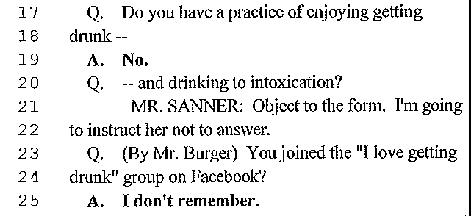
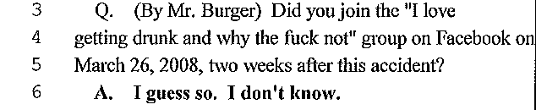
Social Media in Depositions
Tell clients to stay off of social media about their cases.
  But also prepare for when they do not listen

Slide 12
The Whole Truth
Client must be truthful about EVERYTHING

Slide 13
Questions about Investigation
Did DFT investigate this incident?
  Yes: Great! What did you do/what did you find?
  No: So this kind of thing has never happened before, and it’s a strange occurrence, but you never looked into it?
Always investigate subsequent remedial measures
  DFT: Admit a measure was made because of this incident, and it won’t come in against you

Slide 14
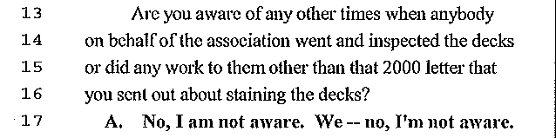
In 1994 “The garden unit decks were in horrific condition. The wood was rotting-it was rotting out”.
“The Association didn’t repair or maintain any of the town home decks for the 20 years”.

Slide 15
DOCTORS
Qualifications, when first seen, history, physical exam, tests, diagnosis, causation, RDMC, prognosis, treatment, how are at end, medical bills and future medical.
See examples in written materials

Slide 16
Always talk about the money the doctor makes from testifying

Slide 17
In PI cases, establish whether the doctor has an independent recollection of events (outside of the records)
  Often, very little recollection
Did the lawyer provide the doctor his opinions?

Slide 18
Rules- Appendix I
Establish legal obligations and breaches
Establish what the contract or custom and practice required, and show how violated
Simple and straight forward
DFT: Establish what rules the plaintiff violated
  e.g., must mitigate damages, can’t exaggerate symptoms

Slide 19
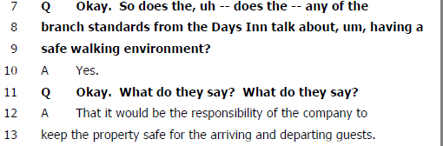
Rules for Hotels and Ice

Slide 20
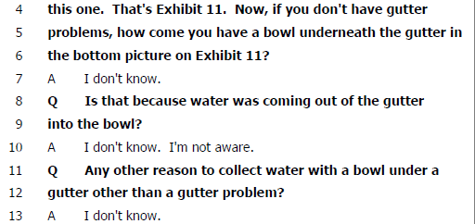
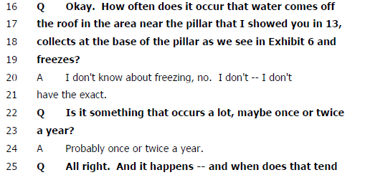


Slide 21
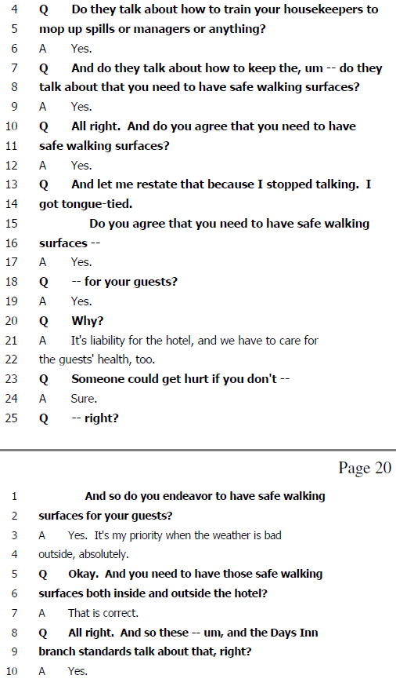

Slide 22
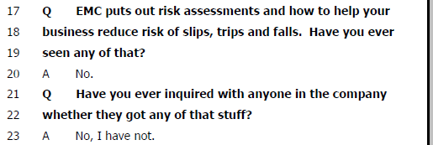
Rules from Insurance Companies

Slide 23
Rules in Auto Crashes

Slide 26
Rules in Trip and Fall

Slide 27
Rules
Get to the simple truth of every proposition.
  Don’t overly complicate simple ideas
Ask the defendant in a tort case or in a breach of contract case what they could do differently

